Slide 1



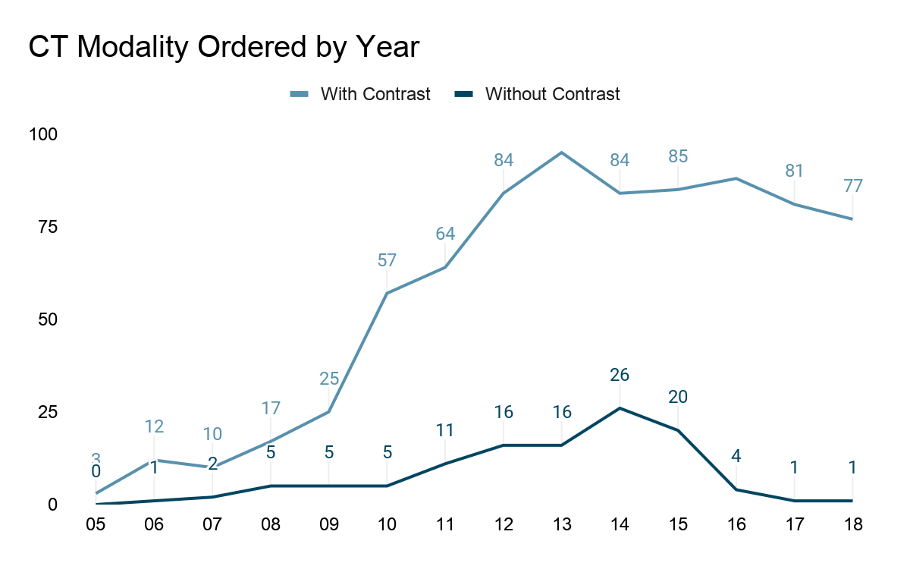
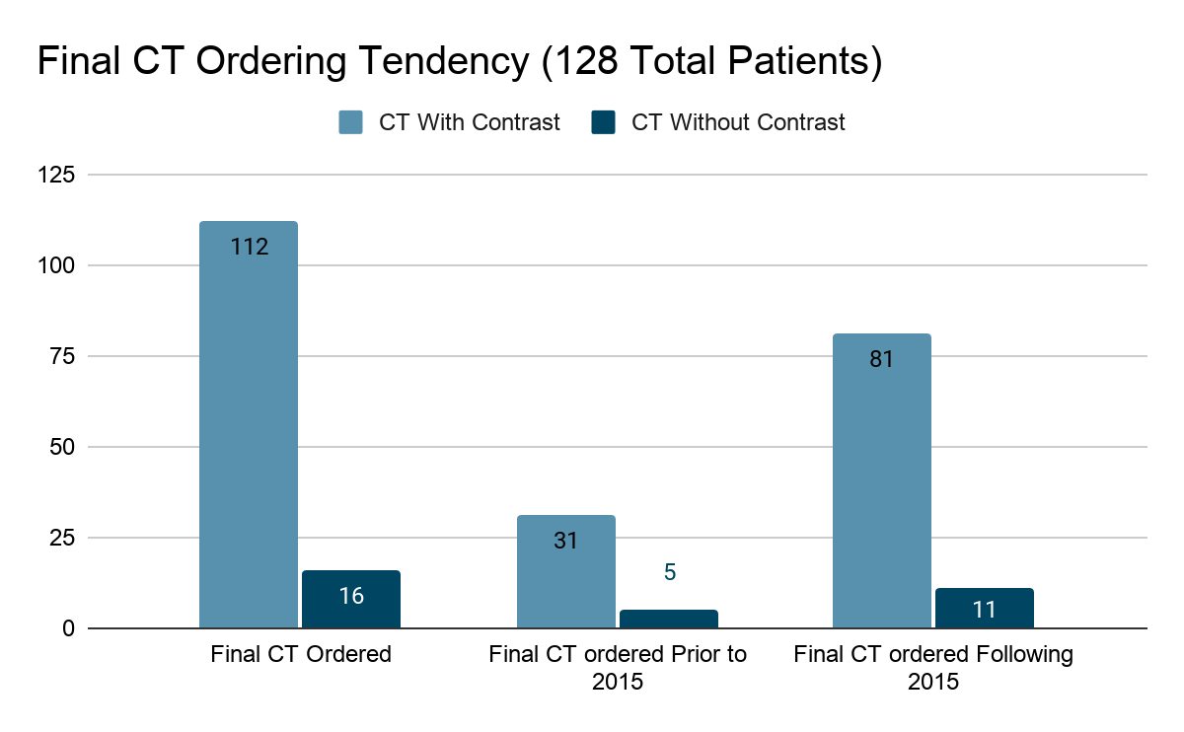
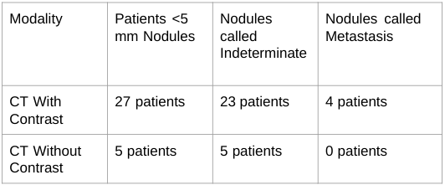
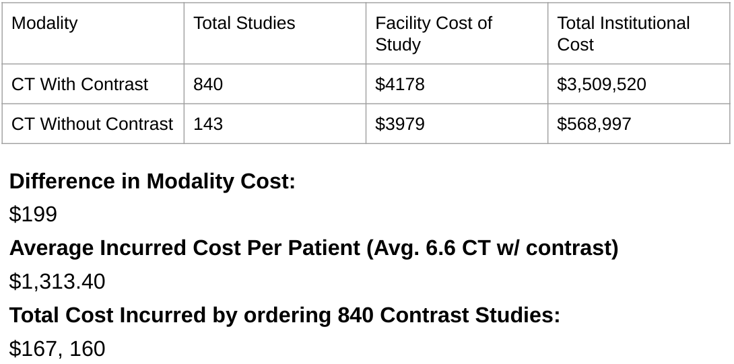
The use of contrast in CT staging of patients with extremity sarcoma: is it over utilized and unnecessary?
Department of Orthopaedic Surgery
Jacob Priester, MS4, UCD SOM; Steven Thorpe, MD, PI, Department of Orthopaedic Surgery; Cyrus Bateni, MD, Department of MSK Radiology; Justin Choi, MS1, UCD SOM
Introduction
Results
QR Code for Abstract
Summary
Background:
Lungs are the most common site of metastasis for bone/soft tissue sarcoma.
Regular lung metastasis staging studies are standard.
American College of Radiology (ACR) recommends CT without contrast for staging since 2015.
Identified Quality Improvement Issue:
At UC Davis there is a tendency to perform CT of the chest with contrast for routine staging.
It is suspected that CTs ordered without contrast are replaced with contrast studies.
The exact frequency of ordering CT of the chest with contrast is unknown.
Institutional Effect:
There is unnecessary cost and procedure to both the patient and hospital.
This is where the copy goes
Our investigation revealed several striking findings:
The overwhelming majority of providers across all specialties are ordering CT with contrast for staging.
98.4% of our population had at least 1 CT with contrast
26 total CTs ordered without contrast were altered to CT with contrast
Even after the ACR guidelines, ordering tendencies have not improved.
Of the 342 total studies ordered after 2015, 93.2% (319), were ordered with Contrast
81 (88.0%) of the final staging CTs ordered after 2015 were ordered with contrast.
Small sample size, but contrast did not appear to obviously assist with diagnosis of <5mm nodules.
Over the last 15 years, UC Davis and patients have incurred an additional $167,160 in unnecessary costs.
Figure 1: This line graph depicts total number of CTs ordered yearly from 2005 to 2018 for all 128 patients. It distinguishes CT with vs without contrast. Even after 2015, there are substantially more CTs with contrast than without contrast.
Average # of CTs with Contrast per patient: 6.6
Average # of CTs without Contrast: 1.1
Figure 2: This bar graph represents the final CT ordered for all 128 patients. 112 patients had CT with contrast ordered for their final imaging modality at UC Davis. It segregates the ordering tendencies both before and after 2015.
Hypothesis
Conclusions/Further Study
CT Chest imaging with contrast is frequently ordered by non-sarcoma specialists for sarcoma metastasis screening. Non-contrast CT of the chest orders are often converted to contrasted studies. Contrasted CT imaging incurs unnecessary patient and institutional cost.
UC Davis continues to order screening chest CTs for sarcoma patients with contrast.
There has been minimal improvement of this activity despite ACR guidelines.
There is an opportunity to educate ordering providers from all specialties.
Improving ordering patterns will reduce both patient and institutional costs.
Will allow more time efficient scheduling of exams
Possibly improved patient experience w/ fewer IVs
Ordering with guidelines in the future could contribute to non-inferiority study.
Figure 3: This table compares diagnosis of <5mm nodules. Of the 32 patients with <5 mm nodules initially called, 28 (87.5%) were labelled as indeterminate.
Only 4 patients (12.5%) with <5 mm nodules were labelled as metastasis. All of these patients underwent CT with contrast.
Methods
Retrospective chart review of 366 sarcoma patients.
Compared CT ordering yearly & among specialists.
Compared diagnoses of <5mm nodules between modalities.
Analyzed cost between CT modalities.
Inclusion Criteria:
Diagnosis of extremity bone/soft tissue sarcoma.
Must have undergone CT for staging/surveillance.
No restriction to length of follow-up or age.
Exclusion Criteria:
CT imaging completed outside UC Davis.
Exams that include CT of the Abdomen/Pelvis.
Myxoid liposarcoma/atypical lipomatous tumor/ well differentiated liposarcoma.
Total Patients Meeting Criteria: 128 of 366 patients
Figure 4: This figure represents the average cost per patient incurred by ordering the average number of CTs with contrast per patient in our population (6.6 CTs with contrast). It also depicts that total cost by the entire patient population for all of the CTs with contrast ordered.
References
Billingsley KG, Burt ME, Jara E, et al. Pulmonary metastases from soft tissue sarcoma: analysis of patterns of diseases and post metastasis survival. Ann Surg. 1999;229(5):602–612.
Digesu CS, Wiesel O, Vaporciyan AA, Colson YL. Management of Sarcoma Metastases to the Lung. Surg Oncol Clin N Am. 2016;25(4):721–733.
Dangoor A, Seddon B, Gerrand C, Grimer R, Whelan J, Judson I. UK guidelines for the management of soft tissue sarcomas. Clin Sarcoma Res. 2016;6:20.
American College of Radiology ACR Appropriateness Criteria for Follow-up of Malignant or Aggressive Musculoskeletal Tumors. Catherine C. Roberts, Mark J. Kransdorf, Francesca D. Beaman, Ronald S. Adler, Behrang Amini, MD, Marc Appel, Stephanie A. Bernard, Ian Blair Fries, Isabelle M. Germano, Bennett S. Greenspan, Langston T. Holly, Charlotte D. Kubicky, Simon Shek-Man Lo, Timothy J. Mosher, Andrew E. Sloan, Michael J. Tuite, Eric A. Walker, Robert J. Ward, Daniel E. Wessell, Barbara N. Weissman. Available at https://acsearch.acr.org/dfddfgfdocs/69428/Narrative/. American College of Radiology.
Bottinor W, Polkampally P, Jovin I. Adverse reactions to iodinated contrast media. Int J Angiol. 2013;22(3):149–154.
Dobbs MD, Lowas SR, Hernanz-Schulman M, Holt GE, Yu C, Kan JH. Impact of abdominopelvic CT on Ewing sarcoma management. Acad Radiol. 2010;17(10):1288-1291.
King DM, Hackbarth DA, Kilian CM, Carrera GF. Soft-tissue sarcoma metastases identified on abdomen and pelvis CT imaging. Clin Orthop Relat Res. 2009;467(11):2838–2844.
Rastogi, R., Garg, R., Thulkar, S. et al. Unusual thoracic CT manifestations of osteosarcoma: review of 16 cases. Pediatr Radiol (2008) 38: 551.

